Slide 1

RECENT TRENDS IN CIVIL ENGINEERING
Dr. Pradeep Kumar
Professor
Civil Engineering Department
H.B.T.U. Kanpur

Slide 2
Topics to be covered……..
Sustainable Construction
Concept of green building
Green Building
Low cost housing
Prefabricated Buildings
Nano Concrete
Bacterial Concrete

Slide 3
Topics to be covered……
Bacterial Concrete
Decorative Concrete
Plastic waste in Concrete Construction
Case Study
Conclusion

Slide 4

SUSTAINABLE CONSTRUCTION
Sustainable construction aims at reducing the environmental impact of a building over its entire lifetime, while optimizing its economic viability and the comfort and safety of its occupants.

Slide 5
WHY NEEDED….???
The rising concern for the environment in response to global warming is driving thinkers to seek sustainable solutions.
The real estate industry is a significant contributor to the global warming due to extensive emissions of greenhouse gases (GHGs) from the energy use in buildings.
Construction industry contributes to nearly 40% of energy consumption.

Slide 6
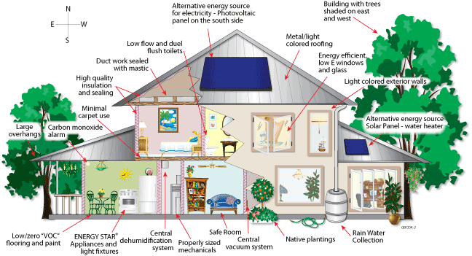
CONCEPT OF GREEN BUILDING

Slide 7
INTRODUCTION
There is increasing evidence that human activities are causing an irreversible damage to the global environment, which will have an adverse impact on the quality of life of future generations.
The construction industry in India is growing rapidly at a rate of 10% compared with the world average of 5.2%.
Buildings in India consume about 20% of the total electricity in the country.
Hence, real estate activity in India has a significant impact on the environment and resources.
Indicates that there is a real opportunity to develop green buildings in the country.
.

Slide 8
DEFINITION OF GREEN BUILDING
A GREEN BUILDING is one whose construction and lifetime operation assures the healthiest possible environment while representing the most efficient and least disruptive use of land, water, energy and resources.

Slide 9
OBJECTIVES OF GREEN BUILDING
To reduce energy use in buildings so as to reduce energy costs and greenhouse gas emission into the earth’s atmosphere.
To minimize the total environmental impacts while enhancing user comfort and productivity.

Slide 10
ELEMENTS OF GREEN BUILDING
Sustainable Site Design
Water quality and Conservation
Energy and Environment
Indoor Environment Quality
Materials and Resources

Slide 11
BENEFITS OF GREEN BUILDING
TANGIBLE BENEFITS:
Operational Savings
Energy Efficiency
Water Efficiency
Waste Reduction
INTANGIBLE BENEFITS
Green buildings provide better air quality, natural light and an optimal and pleasant indoor environment. Enhanced IEQ (Indoor Environmental Quality)

Slide 12
RATING SYSTEMS
LEED-(Leadership in Energy and Environmental Design)
LEED was developed and piloted in the USA in 1998 as a consensus based building rating system based on the use of existing building technology.
RATINGS | CREDIT REQUIRED
LEED CERTIFIED | 23-27
LEED SILVER | 28-33
LEED GOLD | 34-44
LEED PLATINUM | 45-61

Slide 13
GREEN BUILDING MATERIALS
FEATURES
Pollution preventive
Recycled content
Embodied energy reduction
Use of natural materials
Reduction of construction waste
Local materials
Energy efficiency
Water treatment & conservation
Use of non or less toxic materials
Renewable energy system
Longer life
Reusability
Recyclability
Biodegradability

Slide 14
FOUNDATION MATERIALS
FLY ASH CONCRETE
Fly ash is a fine, glass-like powder recovered from gases created by coal-fired electric power generation, reduces energy needed in processing, requires less water & easier to use in cold weather & less likely to crack, has greater workability and strength.

Slide 15
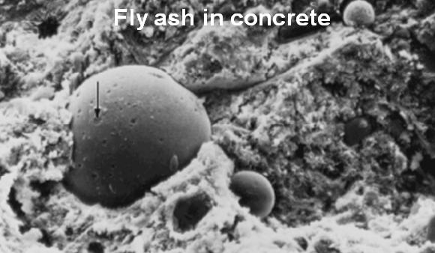

Slide 16
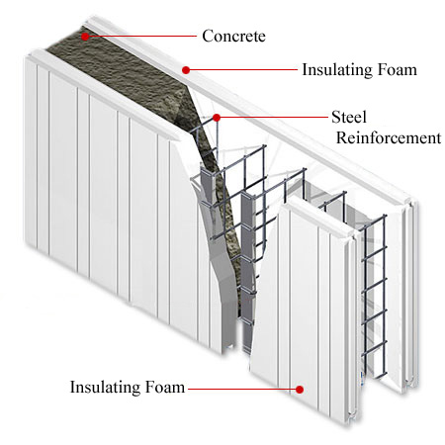
Insulated Concrete Form

Slide 17
INTERIOR & EXTERIOR FINISH MATERIALS
Wheat Board
Plywood
Corrugated metal
Natural clay plaster
Natural fiber wall covering
Low/no VOC(Volatile Organic Compounds) paints, stains & coverings

Slide 18
Low/no VOC paints & Corrugated metal

Slide 19
FLOORING MATERIALS
Recycled Content PET Carpet
Natural linoleum
Wool & wool blend carpets
Natural cork & bamboo flooring
Sustainable harvested wood

Slide 20
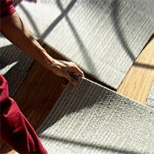
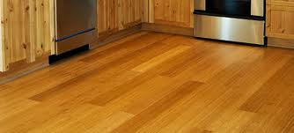
Different types of flooring

Slide 21
INSULATION MATERIALS
Fiber glass batts
Cellulose
Cotton batt & loose fill insulation
Spray foam insulation
Rigid foam insulation
Straw bale
Earthen structures

Slide 22
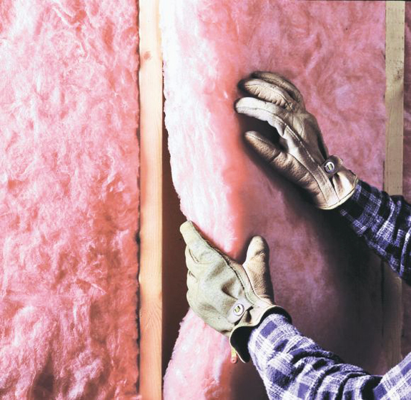
Fiberglass batts

Slide 23
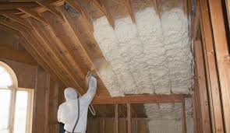
Spray Foam Insulation

Slide 24
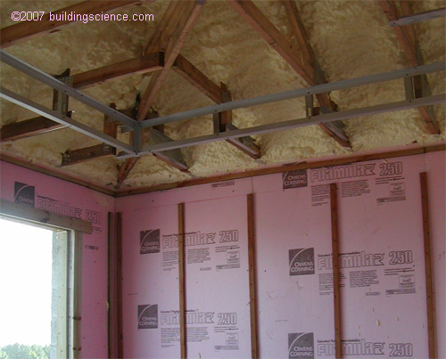
Rigid Foam Insulation

Slide 25
ROOFING MATERIALS
Steel
Structural Insulated Panels (SIPs)
Oriented Strand Boards
Composites

Slide 26
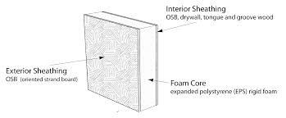
Structural Insulated Panels

Slide 27
HEATING,VENTILATON & AIR-CONDITIONING
Geothermal System
Solar Thermal System
High efficiency & proper sizing
Solar photovoltaic System

Slide 28
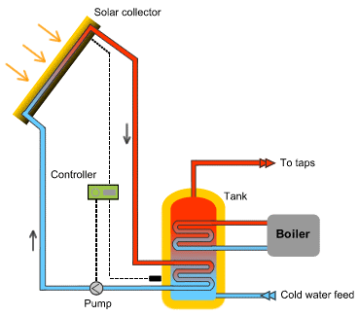
Solar Thermal System

Slide 29
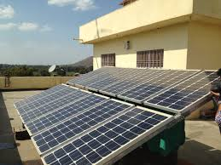
Solar Photovoltaic System

Slide 30
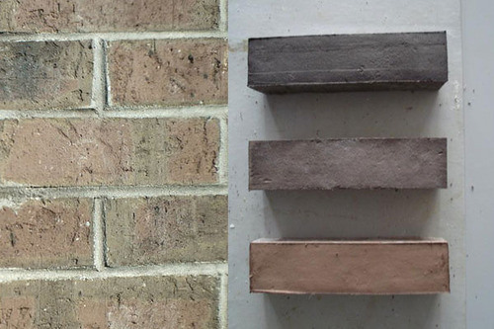
Wool Bricks

Slide 31
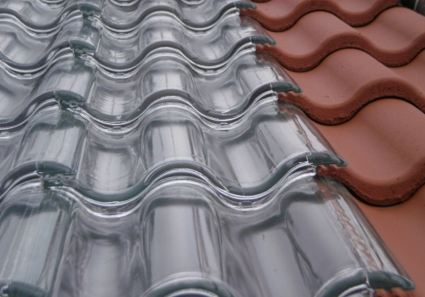
Solar Tiles

Slide 32
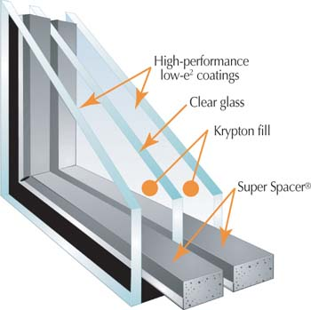
Triple Glazed Windows

Slide 33
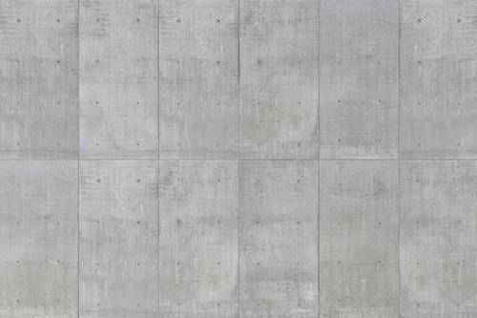
Sustainable Concrete

Slide 34
ASPECTS OF GREEN CONSTRUCTION
Site Selection
Building Footprints
Smart Sizing
Orientation & shape of building
Day lighting
Passive solar design
Passive cooling
Reducing heat island effect
Water treatment

Slide 35
SITE SELECTION
Identify materials at job site & recycle 50% of construction waste
Allocate space for recycle bins
Reuse existing buildings
Preserve valuable trees & plants
Retain native soils & avoid grading

Slide 36
SMART SIZING
Odd dimensions require more material cuts, additional labor and result in a larger volume of construction waste
The structure’s dimensions should be consistent with the standard modules of common construction materials
If the entire building footprint is divisible by 32 square feet, the total construction waste stream can be reduced to around 5 percent

Slide 37
ORIENTATION & SHAPE OF BUILDING
Plan orientation to minimize East and West facing facades, North and South facing facades have significantly less exposure to solar gains
On East and West facing facades, consider minimizing the no. & size of openings & provide shading
Square dimensions are more resource efficient than are rectangular dimensions. Square building footprints and walls enclose more volume per square foot of building envelope than rectangular dimensioned building envelopes

Slide 38
DAY LIGHTING
Natural daylight saves electricity by reducing the need for artificial lighting
Provide clerestory windows & skylights
Optimize daylight glazing & glare free vision

Slide 39
Effective height of daylight glazing

Slide 40
Orientation of buildings to prevent solar exposure

Slide 41
REDUCING HEAT ISLAND EFFECT
Decreasing impervious surface areas & incorporating a tree canopy in the landscaping
Light & reflective colors should be used
Tree shade surface areas should be increased as they absorb heat

Slide 42
WATER TREATMENT
Use low flow plumbing fixtures
Rainwater collected from roofs or paved parking lots can be used for flushing toilets and landscape irrigation
Pervious paving should be encouraged
Roof leader disconnect is a method used to intercept rainwater from impervious roofs and direct it into soak away pits, rain barrels, swales or detention facilities
direct water from the sink drain to the toilet tank, where it is used to flush toilets

Slide 43
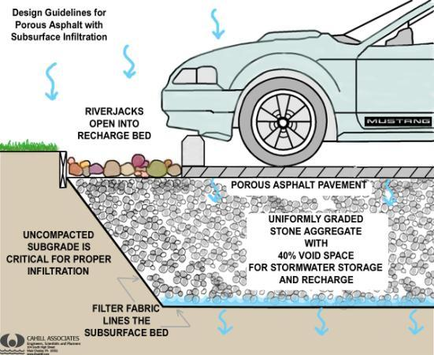
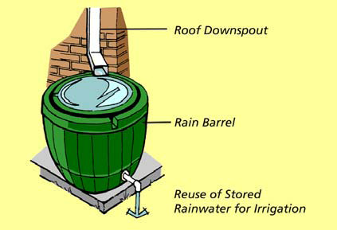
Pervious asphalt paving & Roof leader disconnect

Slide 44
Centre for Environmental Sciences IIT KANPUR
(5 Star GRIHA Rated Building)

Slide 45
CESE
CESE is a research facility at the IIT, Kanpur
Plot area 17500 square meter
Facilities- Laboratories, seminar rooms, discussion rooms
Designed in a sustainable & environment friendly manner

Slide 46
WATER CONSERVATION
Landscape water demand by more than 50% is achieved by min grass area & max green area by native vegetation & trees
Low flow Plumbing Fixtures used reducing water consumption by 62%
Waste water treated & reused in irrigation
Rain water harvesting system is designed

Slide 47
ENERGY- END USE
Architectural design as per climate of Kanpur, sun path analysis, predominant wind direction & existing vegetation
Optimized building envelope, to reduce cooling load & to achieve thermal comfort
Efficient window design by selecting efficient glazing, external shading & glare free natural daylight
Roof shaded by bamboo trellis & green covers
Common circulation areas are day lit & naturally ventilated

Slide 48
ENERGY-Embodied & Construction
Portland Pozzolana Cement (PPC) with fly ash content is used in plaster and masonry mortar.
Wood for doors is procured from commercially managed forests. Modular furniture made from particle board is used for interiors.

Slide 49
RENEWABLE ENERGY UTILIZATION
Renewable energy from photovoltaic panels provide annual energy requirements equivalent to 30% of internal lighting connected load
Hot water demand is met by solar hot water system

Slide 50
PERFORMANCE
The EPI (Energy Performance Index) of the building is predicted to be 45.43 kWh/m²/annum, which is 41.3% less than the TERI GRIHA benchmark
In comparison to a conventional building, 59% energy savings are predicted in the CESE building
The Centre has attempted to conserve and utilize resources efficiently and recycle, reuse, and recharge the systems at every stage of design and construction

Slide 51
Precast Construction

Slide 52
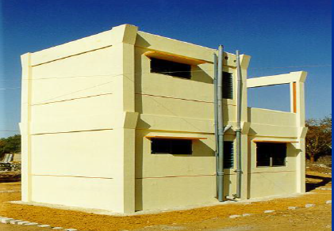
INTRODUCTION
The components are readymade and self supporting.
The mould for the precast components can be used for large number of repetitions.
Time is saved by the use of precast elements which are casted off-site.
Increased productivity and economy
the work at site is reduced to minimum, thereby, enhancing the quality of work, reliability and cleanliness

Slide 53
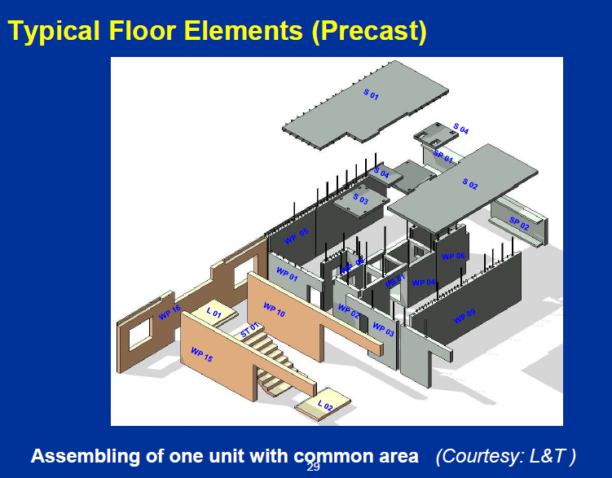

Slide 54
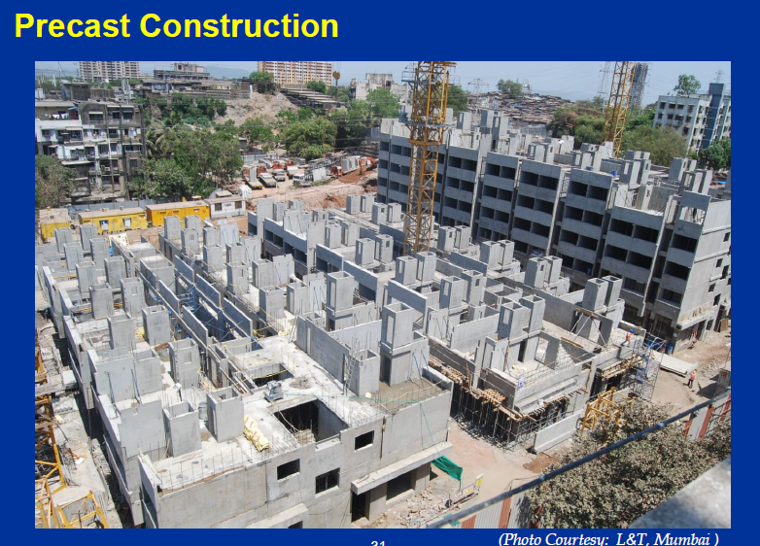

Slide 55
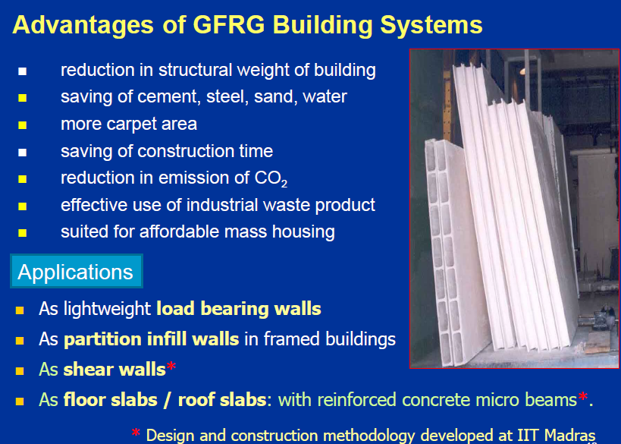
GFRG Building System

Slide 56
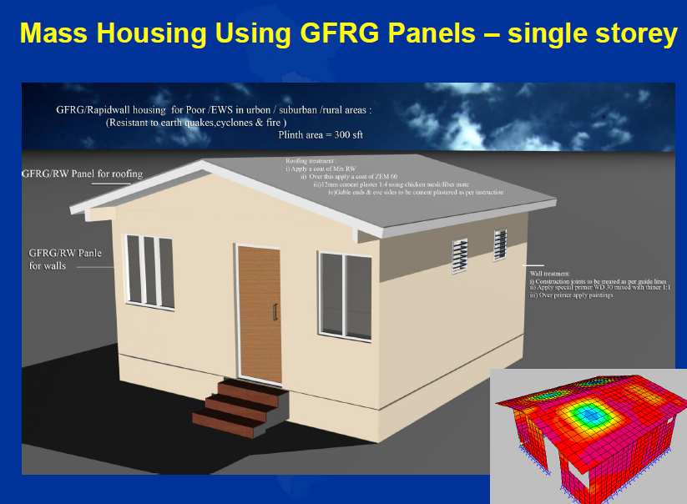
GFRG Building System

Slide 57
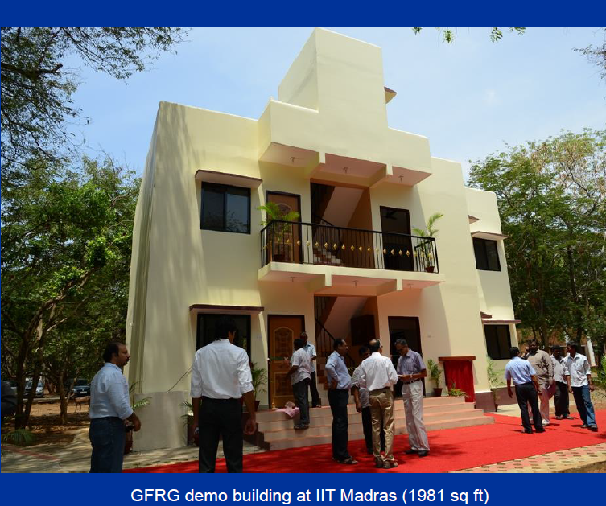
GFRG building System

Slide 58
Cold Formed Steel (CFS) Housing System
Made by rolling or pressing thin gauges of sheet steel into structural elements.
Were introduced to the Indian market lately in the 1990’s.
Complete building package is supplied by a single vendor, compatibility of all the building components and accessories is assured.
When a building is no longer needed it can be disassembled, stored or moved to another location and re-erected because only bolted connections are used

Slide 59
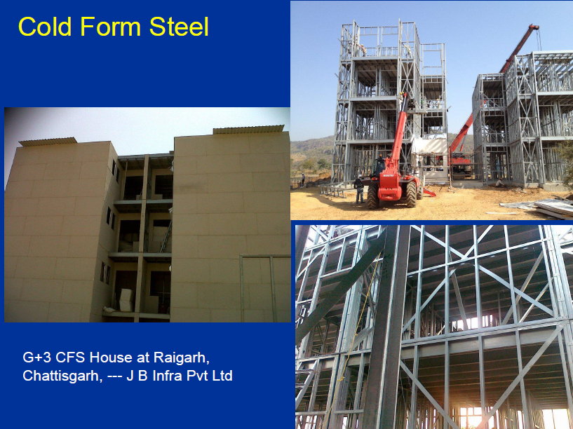
Cold Formed Steel (CFS) Housing System

Slide 60
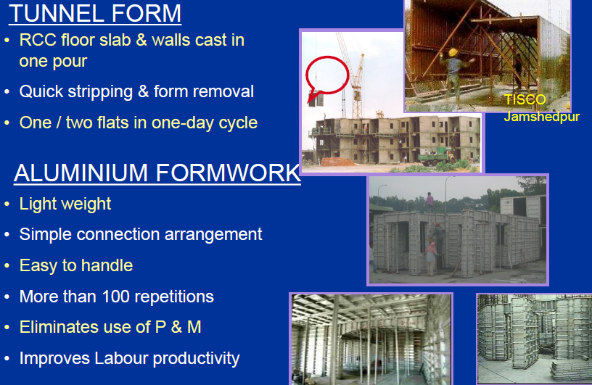
Mechanized Formwork System

Slide 61
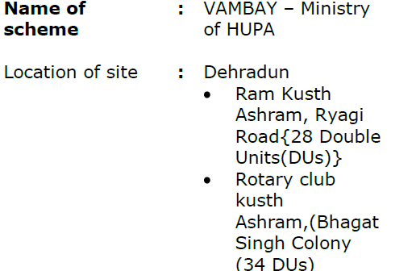
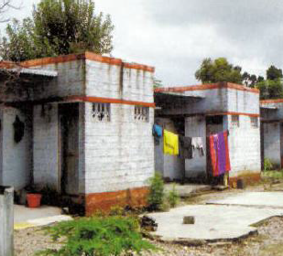
CASE STUDY (PRECAST TECHNIQUE)
Demonstration Housing Project at Dehradun, Uttarakhand

Slide 62
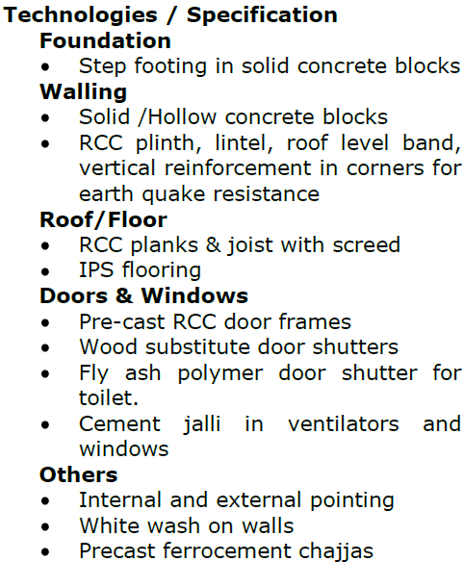
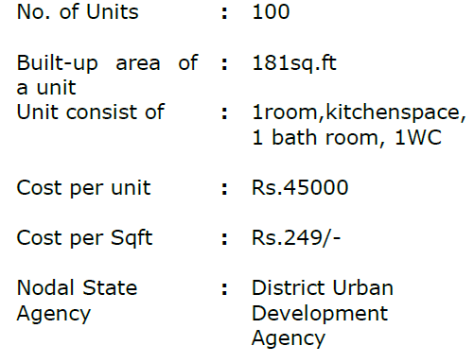
CASE STUDY (PRECAST TECHNIQUE)

Slide 63
Pre-fabricated buildings
Pre-fabricated buildings are those buildings the parts of which
are manufactured in a factory and are transported to the desired site
to assemble the same.
Can be used: steel, concrete, reinforced concrete, wood, asbestos,
cement, aluminium alloys and plastics
For loading and handling assembly equipment such as
cranes and loaders are used
Very efficient in erection

Slide 64
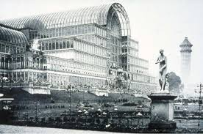
Fig.1 CRYSTAL PALACE LONDON
Source: www.wikipedia.org

Slide 65
TYPES OF PREFABRICATED BUILDINGS
Modular
2. Self Supporting Panel based
3. Metal Structure Frame based

Slide 66
MODULAR
sectional prefabricated buildings that consist of multiple sections
called module.
modules can be placed side-by-side, end-to-end, or stacked
Modules are of 5 types :
4-Sided Modules: Modules are manufactured with four closed
sides to create cellular type spaces designed to transfer the
combined vertical load of the modules above and in-plane loads
(due to wind action) through their longitudinal walls
2. Partially open-sided Modules: 4 sided modules can be designed with partially open sides by introduction of corner and intermediate posts and by using a stiff continuous edge beam in the floor cassette.

Slide 67
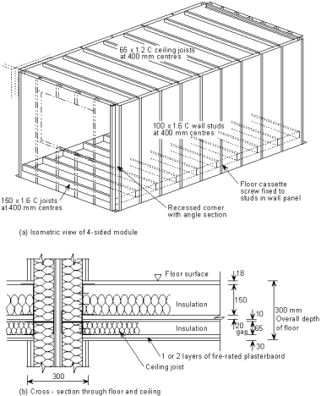
Fig.2. Details of 4 sided modules showing recessed corners with additional angle sections
Source:www.steelconstruction.info

Slide 68
3. Open-sided(corner supported)modules: Modules may be
designed to provide fully open sides by transfer of loads through
the edge beams to the corner posts. The framework of the module
can be hot rolled steel members, such as Square Hollow Section
(SHS) columns and Parallel Flange Channel (PFC) edge beams
that are bolted together
4. Mixed modules and floor cassettes: In this ‘hybrid’ or mixed form
of construction, long modules may be stacked to form a
load-bearing serviced core and floor cassettes span between the
modules and load-bearing walls.
5. Modules supported by a primary structure: the supporting columns
are positioned at a multiple of the width of the modules
(normally 2 or 3 modules). The beams are designed to support the
combined loads from the modules above (normally a maximum
of 4-6 storeys)

Slide 69
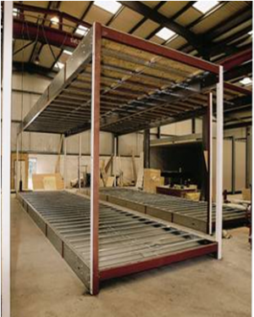
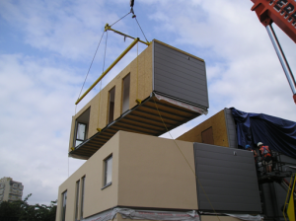
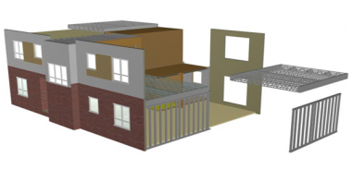
Fig.3. partially open sided module(top left corner), open sided module
(top right corner) and mixed module (above)
Source: www.steelstructure.info

Slide 70
Self supporting Panel based
consist of self-supporting panels joined by bolts
box-like structure,
both vertical and horizontal elements are load-bearing
one-story high wall panels
Metal Structural frame based
Components are usually linear elements (beam-pillar frames
are rare because difficult to handle)
The beams are seated on corbels of the pillars usually with
hinged-joints (rigid connection is also an option)
Joints are filled with concrete at the site

Slide 71
Fig.4. assembling of panels(above)
metal structure frame(below)
Source: Techmash Bulletin

Slide 72
PREFABRICATED VS COVENTIONAL CONSTRUCTION
In Prefab building the construction time of the building can reduce by 30%-50%.
In conventional means materials are directly delivered to the site and a ‘cut-as-you-go’
approach is used to put together a building.
Wastage in prefab construction is less because the quantity of materials used is almost
exact as estimated. In conventional means the material get wasted in transportation
or manual misuse by labour.
In prefab construction the distance to be transported increases as the materials have
to be transported to factory first and then the modules are transferred to the site.
In conventional means the distance is less as only materials are to be transferred to
the site.
In prefab construction the energy is used in fabrication, heating and cooling of factory.
The transportation of modules also require extra fuel.
In conventional means, the energy is used in operating equipments like cranes,
generators, occasional heating to protect interior finishes of the building.

Slide 73
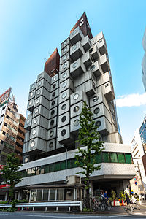
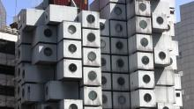
CASE STUDY
NAKAGIN CAPSULE TOWER
Located in Shimbashi, Tokyo, Japan
Completed in 1972
Houses 140 prefabricated modules which are each self-contained units
Each capsule measures 2.3 m (7.5 ft) × 3.8 m (12 ft) × 2.1 m (6.9 ft)
Construction occurred on site and off site
Fig.5. Nakagin Capsule Tower
Source: http://www.koma-modular.cz/en/vyrobkove-rady/comfort-line/priklady-modularni-
architektury-ve-svete/nakagin-capsule-tower

Slide 74
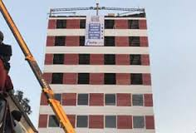
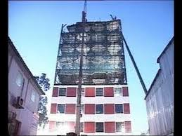
2. INSTACON
Located in Mohali made in 48 hours
Synergy Thrislington infrastructure company
cleared for Zone-V seismic area
The outer wall is a double-skinned PUF panel
Every floor of the building (52 ft x 52 ft) was divided into four
equal-sized blocks (13 ft x 52 ft) or modules.
shell is made of steel which was then covered over with
polyurethane foaming panels
Fig.6. Instacon
Source: Parakram Rautela 's blog-The Times Of India

Slide 75
Nano Concrete
Nanotechnology is one of the most active research areas which has wide applications in almost all the fields.
It deals with the size 100 nanometers or smaller.
As concrete is most usable material in construction industry it’s been required to improve its quality.

Slide 76
Why nanotechnology for concrete?
Improves the materials’ bulk properties.
Ability to control or manipulate materials at the atomic scale. NANOSCALE ATTACK ON ASR (ALKALI SILICATE REACTION)
To obtain thinner final products and faster setting time.
Cost effectiveness.
Lowered levels of environmental contamination.

Slide 77
What is nano concrete?
A concrete made with portland cement particles that are less than 500nm as a cementing agent.
Currently cement particle sizes range from a few nano-meters to a maximum of about100 micro meters.

Slide 78
NANO MATERIALS
Carbon Nanotubes.
Nano-silica.
Polycarboxylates.
Titanium dioxide

Slide 79
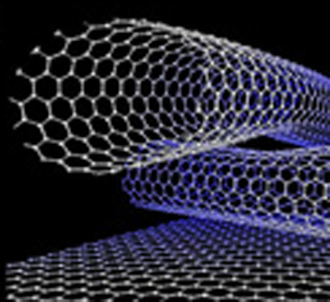
SINGLE WALLED CARBON NANO TUBES

Slide 80
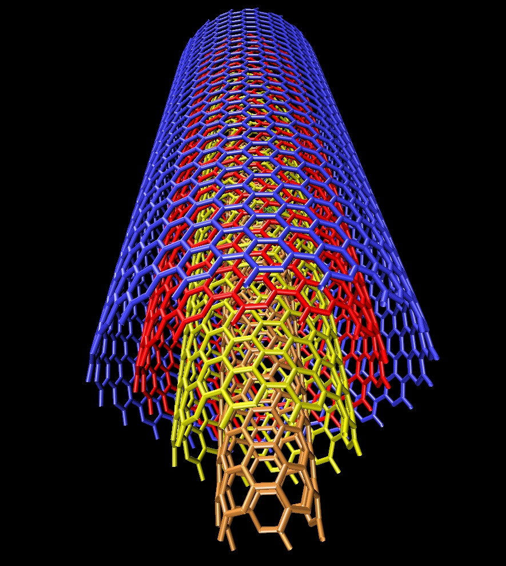
MULTI WALLED CARBON NANO TUBES

Slide 81
NANO SILICA
Is the first nano product that replaced the micro silica.
Advancement made by the study of concrete at nano scale have proved nano silica much better than silica used in conventional concrete.

Slide 82
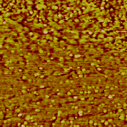
NANO SILICA

Slide 83
PROPERTIES
High compressive strengths concretes ( 15 MPa and 75 MPa at 1 day; 40 MPa and 90 MPa at 28 days and 48 MPa and 120 MPa at 120 days.)
High workability with reduced water/cement ratio.
Use of super plasticizing additives is unnecessary.
Fills up all the micro pores and micro spaces.
Cement saving upto 35-45%.

Slide 84
POLYCARBOXYLATES
Polycarboxylates or polymer based concrete admixtures are High Range Water Reducing admixture (HRWR).
low dosage-reduce water as much as high dosage of conventional admixtures.
Higher dosage-produce Self Compacting Concrete (SCC).
This admixture type is very suitable for underwater anti-washout concrete.

Slide 85
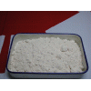
POLYCARBOXYLATES

Slide 86
Titanium dioxide
Obtained from Ilmenite (ore of Titanium dioxide)
Used for making photocatalytic concrete.
It acts as a cleaning agent.
Mostly used in European countries to provide a healthy environment.

Slide 87
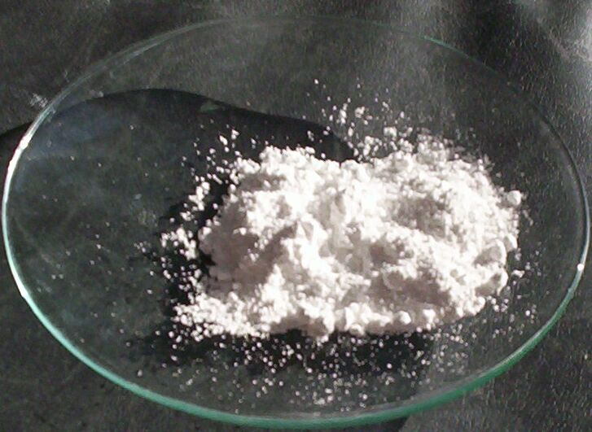
Titanium dioxide
Notes:
Titania

Slide 88
BENEFITS OF NANO CONCRETE
Cessation of contamination caused by micro silica solid particles.
Lower cost per building site.
Concrete with high initial and final compressive and tensile strengths.
Concrete with good workability.
Cessation of super plasticizing utilization.
Cessation of silicosis risk.
Cessation of bacterial activity.

Slide 90
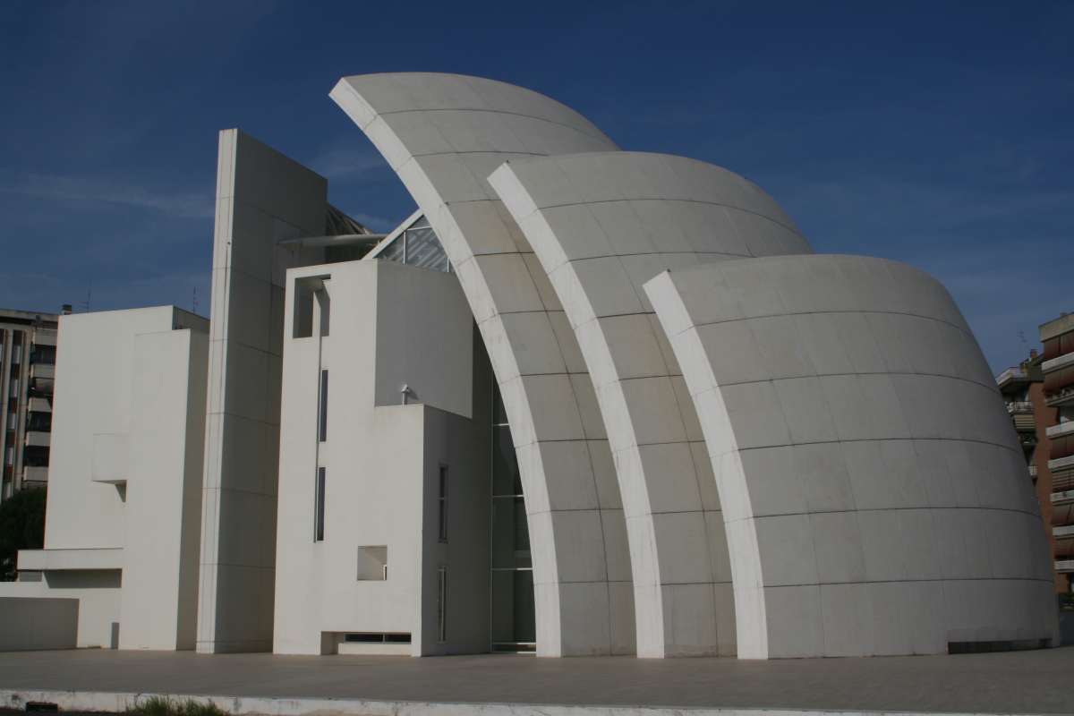
New Jubilee Church in Rome, Italy
Notes:
New Jubilee Church in Rome, Italy

Slide 91

Freedom Tower in New York
Notes:
Freedom Tower in New York

Slide 92
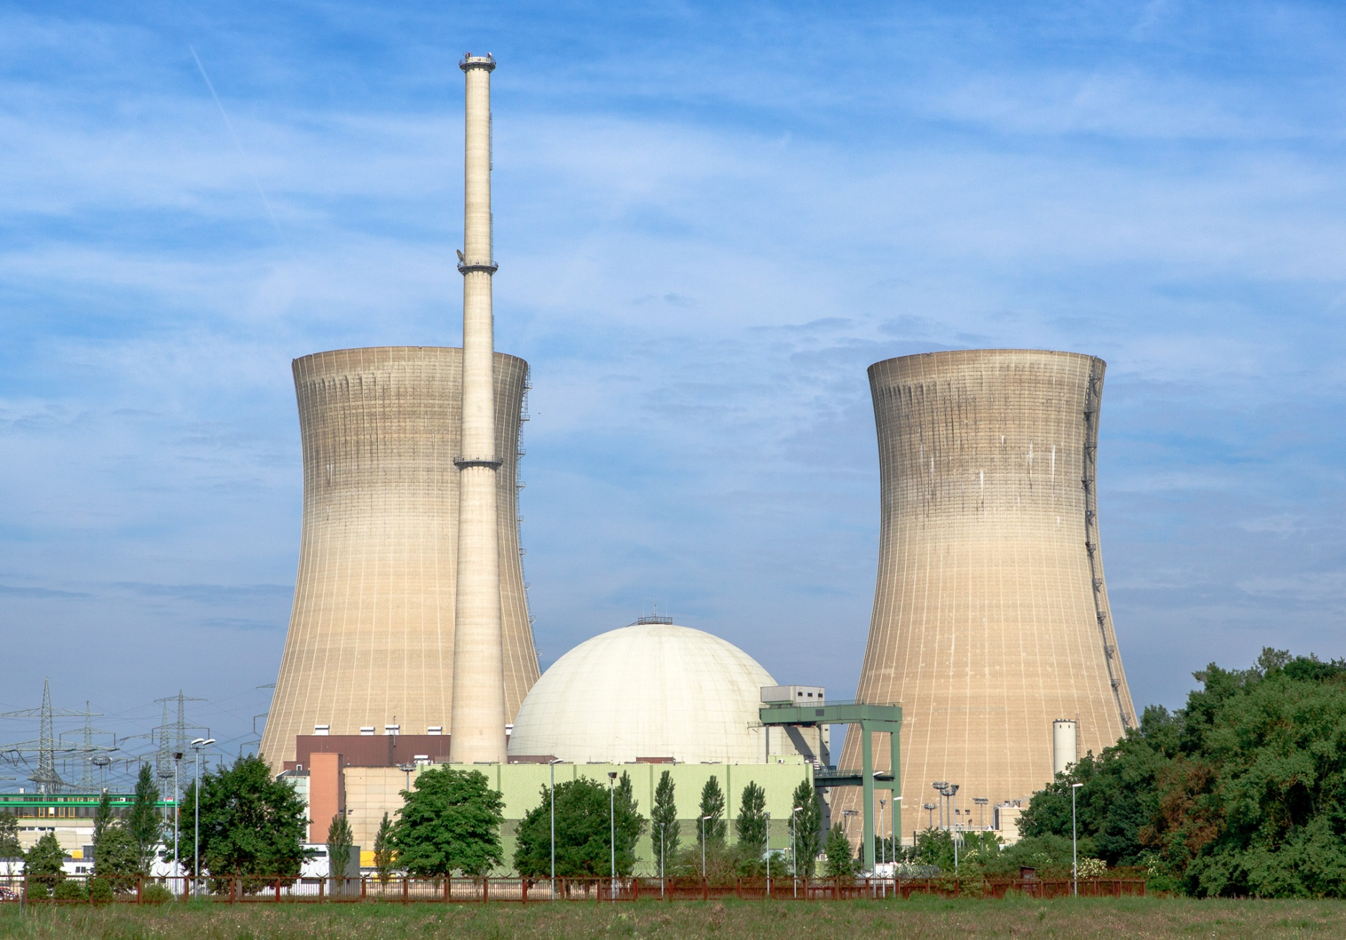
Nuclear Reactor in Germany with containment building
Notes:
Nuclear Reactor in Germany with containment building

Slide 93
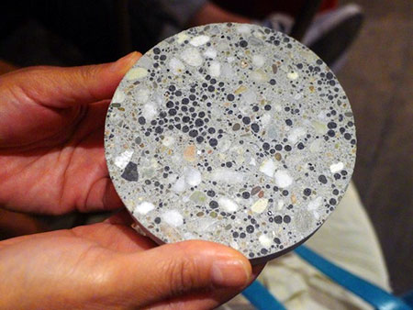
BACTERIAL CONCRETE- A SELF HEALING CONSTRUCTION MATERIAL

Slide 94
Introduction :
Concrete is a material which is the most widely used building material in the world.
Natural processes such as weathering, faults, land subsidence, earthquakes, and human activities creates cracks in concrete structures.
Concrete expands and shrinks with changes in moisture and temperature and this tendency to shrink and expands causes cracks in concrete.

Slide 95
We do not like cracks in concrete because cracks form an open pathway to the reinforcement and can lead to durability problems like corrosion of the steel bars.
These cracks should be repaired because they can reduce the service life of structure.
In case of historical monuments cracks spoils the appearance of structure.
Remediation of already existing cracks has been subject of research for many years.

Slide 96
The various product such as structural epoxy, resins, epoxy mortar, and other synthetic mixtures are used as filling material but they are not environmentally friendly not even safe for human health.
Here are some four possible mechanisms given for self healing of concrete which are as under :
1.) Formation of material like calcite
2.) Blocking of the path by sedimentation of Particles
3.) Continued hydration of cement particles
4.) Swelling of the surrounding cement matrix.

Slide 97
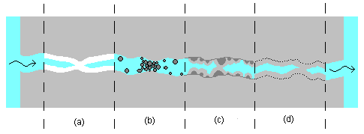
Different healing mechanisms

Slide 98
Bacterial concrete
The "Bacterial Concrete" is a concrete which can be made by adding bacteria in the concrete that are able to constantly precipitate calcite, this phenomenon is called microbiologically induced calcite precipitation.
It is process by which living organisms form an inorganic solids.
It is same process as we people are producing teeth and bones.

Slide 99
“Bacillus Pasteruii ” is a common soil bacterium, which can continuously precipitate a new impermeable calcite layer over the surface of concrete.
Favorable condition does not exist in concrete because of its alkaline nature, pH value of concrete is very high.
In extreme alkaline environment pH of 12 in not favorable for growth of this bacteria, its optimum pH for growth is 9, but bacteria has an ability to produce such material to maintain pH.

Slide 100
How does bacteria remediate cracks ?
As we have seen in previous slides “Bacillus Pasteurii” have an ability to precipitate calcite in environment.
This process of microbiologically induced calcium carbonate precipitation is having a complex biochemical reactions.
B. Pasteurii exhibits Urease which catalyzes the hydrolysis of urea (nutrient) into ammonium (NH⁴⁺) and carbonate (CO₃²⁻).

Slide 101
First, urea is hydrolyzed to Carbamic acid and ammonia. Carbamic acid then hydrolyses to form additionally ammonia and carbonic acid.
CO(NH₂)₂ + H₂O NH₃ + NH₂COOH
NH₂COOH + H₂O NH₃ + H₂CO₃
These products subsequently form bicarbonate and ammonium and hydroxide ions.
H₂CO₃ H⁺ + HCO₃⁻
2NH₃ + 2H₂o 2NH₄⁺ + 2OH⁻

Slide 102
The ammonia is responsible for pH increase, which in turn shifts the bicarbonate equilibrium, resulting in the formation of calcium carbonate ions.
Cl⁻ + HCO₃⁻ + NH₃ NH₄Cl + CO₃²⁻
Ca²⁺ ions are supplied in the form of CaCl₂ is used to grow the bacteria and also to control the pH.
After this process in surroundings ions Ca²⁺ And
CO₃ ²⁻ precipitate as CaCO₃.
Ca²⁺ + Cell Cell-Ca²⁺
Cell-Ca²⁺ + CO₃²⁻ Cell- CaCO₃

Slide 103
Observed crack healing in concrete

Slide 104

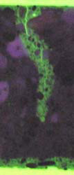
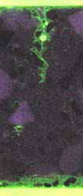

Image showing effect of healing

Slide 105
Design Aspects
The two self-healing agent parts (the bacterial spores and the calcium based nutrients) are introduced to the concrete within separate expanded clay pellets 2-4 mm wide, which ensure that the agents will not be activated during the cement-mixing process.
When cracks open up the pellets and incoming water brings the calcium lactate into contact with the bacteria these become activated. Testing has shown that when water seeps into the concrete, the bacteria germinate and multiply quickly.

Slide 106
Self Healing Admixture

Slide 107
Comparison between Bacterial Concrete and Conventional Concrete
The microbiologically induced Bacillus subtilis JC3 bacteria improved the compressive strength of cement mortar by 16.15%.
At a particular microbial cell concentration i.e. 10⁵ cells/ml compressive strength of cement mortar is maximum.
Increase in compressive strength of cement mortar is lower at higher cell concentration i.e. 10⁷ cells /ml.

Slide 108
In ordinary grade concrete, the compressive strength is increased up to 13.93% at 28 days on addition when compared to conventional concrete.
In ordinary grade concrete, the split tensile strength has increased up to 12.60% at 28 days when compared to conventional concrete.
In standard grade concrete, the split tensile strength is increased up to 12.09% at 28 days when compared to conventional concrete.

Slide 109
From the durability studies, in ordinary grade and standard concrete, the percentage weight loss and compressive strength loss of cubes immersed in 5% H₂SO₄ and 5% HCL indicates that Bacterial concrete has less weight and strength losses than the conventional concrete.
Similarly, through acid attack test with cubes immersed in 5% H₂SO₄ and 5% HCL indicated that bacterial concrete is more durable in terms of “Acid Durability Factors” than conventional concrete and also bacterial concrete is less attacked in terms of “Acid Attack Factors” than conventional concrete.

Slide 110
Application in Construction Field

Slide 111
Advantages
In Crack Remediation.
Improvement in Compressive Strength of Concrete.
Better Resistance towards Freeze-Thaw .
Reduction in Permeability of concrete.
Improves Durability of Bricks.
Reduction in Corrosion of Reinforced Concrete.

Slide 112
Limitation
Cost of Bacterial concrete is Double than Conventional Concrete.
Growth of Bacteria is not good in any atmosphere and media.
Design of mix Concrete with Bacteria there is no available any IS-code or any code.
Investigation of Calcite precipitation done by “Scanning Electron Microscopy ”is costly studied.

Slide 113
DECORATIVE CONCRETE

Slide 114
What is Decorative Concrete?
Decorative concrete is created through a finishing process that is intended to provide an aesthetic quality.
Various patterns, textures, and colors are applied to create decorative effects that enhance and beautify concrete.

Slide 115
Concrete finishing techniques turn ordinary concrete projects into artistic impressions suitable for exterior and interior custom design applications.
Design experts use decorative concrete as a cost effective substitute for natural stone, brick, and other more expensive construction elements.

Slide 116
The commercial and industrial uses for decorative concrete are visible on highways, bridges and buildings.

Slide 117
TYPE OF DECORATIVE CONCRETE
Coloured mixture
Stamped concrete
Form linings
Colored mixture
This is the most widely used decorative concrete.
The coloring agents are usually chemical compounds of chromium and other heavy metals.

Slide 118
USES OF DECORATIVE CONCRETE
Decorative concretes are used on a large scale these days.
These days, new decorative concretes are manufactured with enhanced technologies that creates lighter, faster and stronger cure.

Slide 119
They start working faster and offer a wider range of protection to the concrete.
If you are looking to make a house or even to refurbish the old worn out concrete slabs, you should consider this option quite seriously.
Another great thing with these concretes is that, apart from increasing the aesthetic appeal of your house,

Slide 120
ADVANTAGES OF DECORATIVE CONCRETE
Improved the Aesthetics
Design Flexibility
Long Lasting
Economical
Environment Friendly

Slide 121
Improved the Aesthetics
A decorative coating will transform the slab of cement into a beautiful creation that can stand on its own without covering it up with other ornaments or material.
Design Flexibility
Decorative concrete coatings offer design flexibility that is not available with other floor finishes.

Slide 122
Use them to create stained, acid-etched, stamped, or polished floors, which are cheaper than other floor coverings.
Long Lasting
Concrete is durable and strong, so its rigidity will help it hold up to almost any physical impact.

Slide 123
Economical
Decorative concrete coatings are durable and resistant to most damages so they won’t need constant repairs or maintenance.
With minimal cleaning and re-polishing required, you’ll spend less time and money for upkeep.

Slide 124
Environment Friendly
Decorative concrete coatings play a critical role in green projects.
They promot energy efficiency since they maintain a comfortable inner temperature thereby reducing the energy .

Slide 125
Utilization of Plastic Waste in Road Construction

Slide 126
Introduction
The availability of waste plastic is increasing day by day.
India’s plastic consumption is one of the highest in the world.
Over one million plastic bags are being used every minute and they are damaging the environment

Slide 127
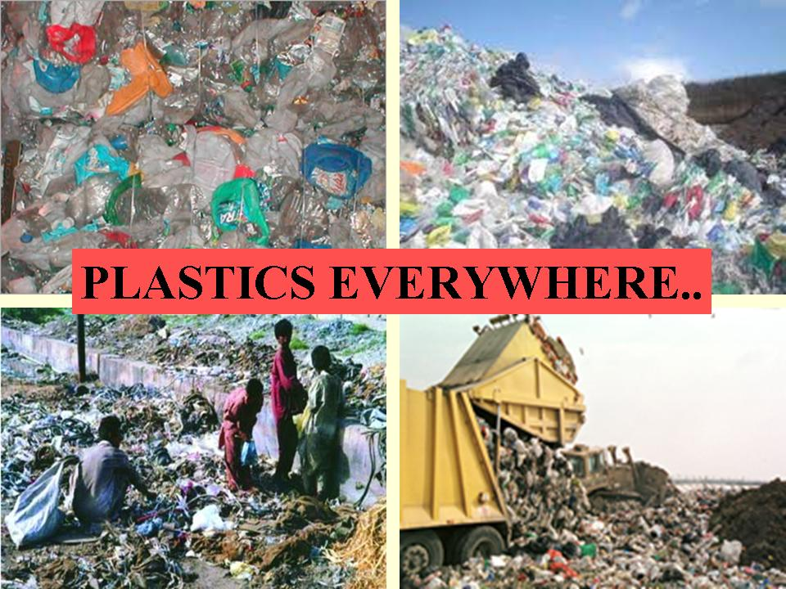
(source: http:// www.tce.edu/ )
The use of waste plastic for road construction is one of the best method for easy disposal of plastic.

Slide 128
What is plastic?
A material that contains one or more organic polymers of large molecular weight, solid in its finished state and at some state while manufacturing or processing into finished articles, can be shaped by its flow, is called as ‘Plastic’. Plastics are of three types-
Thermosetting
Thermoplastic
Elastomers

Slide 129
Classification of plastic waste
Type of waste plastic | origin
Low density polyethylene (LDPE) | bags, detergent bottles etc
High density polyethylene (HDPE) | Bottles of milk, fruit juices, bottle caps etc
Polypropylene (PP) | bottle cap and closures, wrapping for biscuits
Polystyrene (PS) | clear egg packs, bottle caps.
Foamed Polystyrene | food trays, egg boxes, disposable cups,
Polyvinyl Chloride (PVC) | mineral water bottles, credit cards, toys etc
( Source: IOSR Journal of Mechanical and Civil Engineering )

Slide 130
CHARACTERISTICS OF WASTE PLASTIC
Binding Property
Plastic can be used as the binder .the table below shows binding strength of various plastics.
Type of plastic | Percentage of plastic | Binding strength in Kg
Poly ethylene | 10 | 325
Poly propylene | 10 | 350
Poly styrene | 10 | 200
(Source: http://www.tce.edu)

Slide 131
Thermal Behavior
Polymers namely PE, PP and PS get softened easily around 130-140°C without evaluation of any gas. Only above 270°C they either decomposed or burnt to produce gaseous products.

Slide 132
Toxicity
Pure plastic have low toxicity due to their insolubility in water. Figure below shows the toxicity in different plastics. PVC is not recommended in road construction due to its high toxicity.

Slide 133

Toxicity of various plastics
(Source: http://www.tce.edu/)

Slide 134

Material used in waste plastic roads
Aggregate
Size of aggregate used is 10mm to 20mm.

Slide 135

Bitumen
60/70, 80/100 grade bitumen is used

Slide 136

Waste Plastic
Waste Plastic is used in the shredded form.
(source: Reference 2)

Slide 137
BASIC PROCESSES
Segregation
Cleaning
Shredding
Collection
Mixing

Slide 138

Segregation
Segregation process is basically the separation of plastic waste from other solid wastes

Slide 139
Cleaning
Waste plastic litter in the form of thin-film carry-bags, use-and-throw cups, PET bottles etc. these are sorted, de-dusted, washed and dried.
Shredding
Plastics waste (bags, cups, thermocole) made out of PE, PP and PS cut into a size between 2.36mm and 4.75mm using shredding machine, (PVC waste should be eliminated)

Slide 140


Shredding process is shown in the figure.
(source: “Roads from plastic waste”, The Indian Concrete Journal NOVEMBER 2008)

Slide 141
Collection
The plastic waste retaining on 2.36 mm sieve is collected. Collected plastic is then mixed with aggregate or bitumen.

Slide 142
METHOD OF MIXING OF PLASTIC WASTE
Dry Process
Waste Plastic is added to hot aggregates to get Plastic Coated Aggregates (PCA)
Aggregate is heated to 170 degree C in the mini hot mix plant
Then the shredded plastic is added in equal proportion
Then heated bitumen is added

Slide 143

Mixing By Central Mixing Plant
The dry process can also be carried out using central mixing plant
Central mixing plant is shown in the figure below.
( source: International Journal of Application or Innovation in Engineering and Management (IJAIEM), Volume 2, April 2013)

Slide 144
Wet Process
In wet process waste plastic is directly mixed with hot bitumen at 160 degree C.
Mechanical stirring is needed.
the wet process require a lot of investments and bigger plants .
Not used commonly

Slide 145
OPTIMUM WASTE PLASTIC CONTENT
Optimum waste plastic content is the percent by weight at which the stability of the plastic modified bitumen is maximum .Chart below shows the variation of stability with the percentage of waste plastic.
(source: Reference 2)

Slide 146
CHARACTERISTICS OF PLASTIC COATED AGGREGATE
Stone Aggregate | Percentage of plastic | Aggregate impact value | Aggregate Crushing Test | Los Angel’s Abrasion Value
Without plastic coating | 0 | 25.4 | 26% | 37%
With plastic coating | 2% | 18.50 | 20% | 29%
( SOURCE: PROGRAMME OBJECTIVE SERIES: PROBES/122/2008-2009.)

Slide 147
Comparison between plastic roads and conventional bituminous roads.
Roads laid with plastic waste mix are found to be better than the conventional ones.
The durability of the roads laid out with shredded plastic waste is much more compared with roads with asphalt with the ordinary mix.
While a normal 'highway quality' road lasts four to five years it is claimed that plastic-bitumen roads can last up to 10 years.

Slide 148
BENEFITS OF WASTE PLASTIC ROADS
Environmental benefits
Today, plastic waste treatment is largely hazardous to the environment as most of the plastic is burnt resulting is toxic gases being released in the environment. By effectively managing the collection, separation and processing of plastic waste, the environmental damages can be limited by eliminating the waste from our streets.

Slide 149
MSWM (Municipal Solid Waste Management)
At present only 20% of the MSW is converted into compost. This can be considerably increased to 80-85% and more by systematically managing the plastic waste.

Slide 150
National Economy
India spends Rs 35,000 crores a year on road construction and repair, including Rs 100,000 crores a year just on maintenance.
Roads lasting 2-3 times longer, will save us Rs 33,000 crores a year in repairs, plus reduced vehicle wear and tear.
8% by weight of plastic waste in bitumen = a saving of 0.4% of bitumen by weight in roads.

Slide 151

CASE STUDIES
Site-1
Place: Canteen road, TCE, Madurai
Road laying authority: Thiagarajar College of Engineering, Madurai
Date of Road Laying: January 2006
Road length: 600 meter
( Source: Performance Evaluation of Polymer Coated Bitumen Built Roads PROBES/122/2008-2009)

Slide 152

Site-2
Place: Bangalore - Mysore state Highway

Slide 153
CONCLUSIONS
The use of waste plastics for pavement is one of the best methods for easy disposal of waste plastics.
The use of the innovative technology not only strengthened the road construction but also increased the road life as well as will help to improve the environment and also creating a source of income.
It is hoped that in near future we will have strong, durable and eco-friendly roads which will relieve the earth from all type of plastic-waste.

Slide 154
THANK YOU !!!

